Slide 1





Image encryption: Generating visually meaningful encrypted images
Team: Hao Ding & Jianan Ni

Slide 2
How to do ?
To address this problem, there is a new image encryption which is designed to transform an original image into a visually meaningful encrypted one.
To protect image content,
most encryption algorithms transform
an original image into
a texture-like or noise-like image,
which is "confess without being pressed".

Slide 3
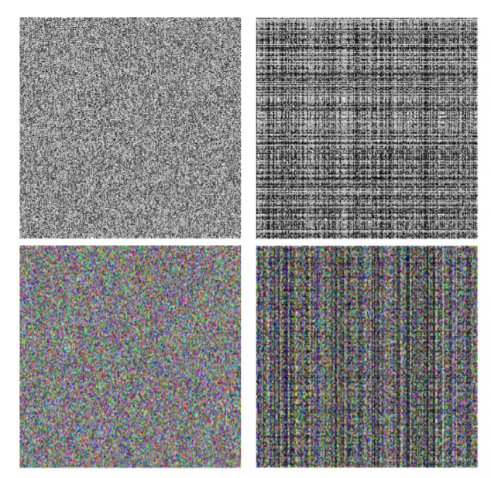
Texture-like
OR
Noise-like image

Slide 4
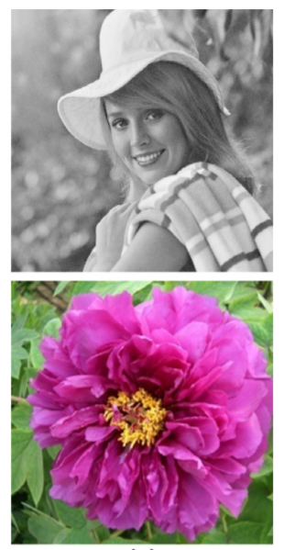



Visually meaningful

Slide 5
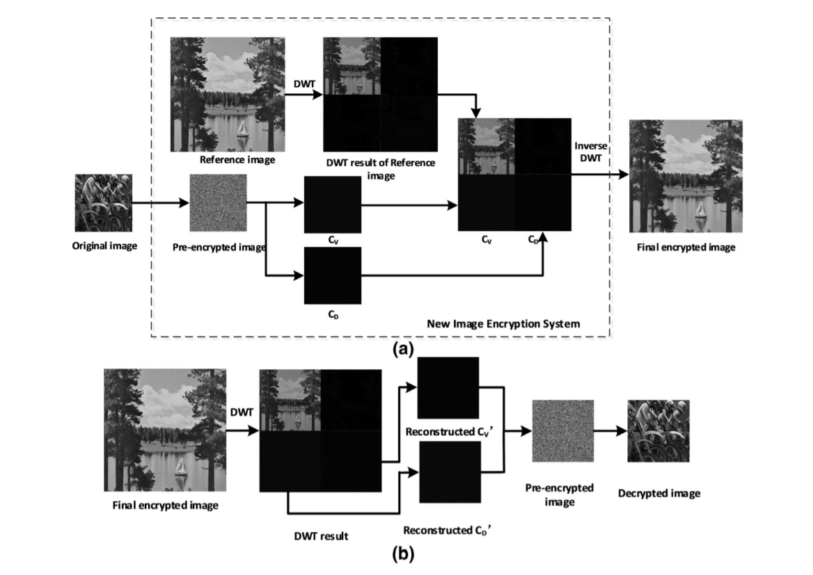

Slide 6
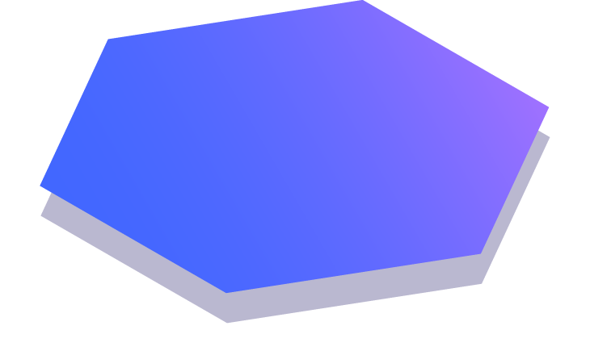
Thanks!
Any questions?
You can find us at:
jnqh4@mail.missouri.edu
hd945@mail.Missouri.edu

